Slide 1

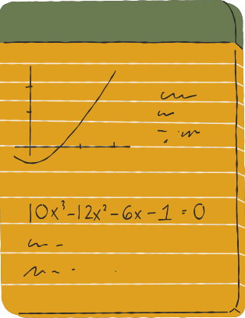










電影票預訂管理系統
MOVIE TICKET BOOKING SYSTEM
B11200037 阮進卿
B11171201 武黃擔
B11171202 楊氏林水

Slide 2
RESEARCH BACKGROUND AND MOTIVATION
WITH THE DEVELOPMENT OF THE DIGITAL AGE, TRADITIONAL TICKET PURCHASING METHODS (SUCH AS QUEUING OR CALLING) CAN NO LONGER MEET THE NEEDS OF USERS, ESPECIALLY WHEN POPULAR MOVIES ARE RELEASED, WHICH OFTEN CAUSES INCONVENIENCE. THIS TOPIC AIMS TO DEVELOP AN EFFICIENT AND CONVENIENT MOVIE TICKETING SYSTEM TO IMPROVE USER EXPERIENCE AND INCREASE TICKET PURCHASING EFFICIENCY.
RESEARCH PURPOSE
THIS PROJECT AIMS TO DEVELOP A MOVIE TICKET MANAGEMENT SYSTEM THAT PROVIDES A USER-FRIENDLY INTERFACE, ALLOWS QUICK QUERY, SEAT SELECTION AND CONVENIENT PAYMENT. AT THE SAME TIME, THE SYSTEM WILL INTEGRATE BACK-END MANAGEMENT FUNCTIONS TO ASSIST CINEMA MANAGERS IN FLEXIBLY ADJUSTING FILM SCHEDULES AND TICKET PRICES.
PROBLEM STATEMENT
MOVIE THEATER ARE NOT WORKING 24/7.
HANDLING MULTIPLE GROUPS AT A SAME TIME IS DIFFICULT AND TIME-CONSUMING.
NON-CASH PAY IS MORE FAVORED NOWADAYS.
SITUATION THAT REQUIRES LESS HUMAN-TO-HUMAN INTERACTION. (COVID-19 FOR EXAMPLE).
CONTRIBUTION
VIEW CURRENT PREMIERE SHOWS.
VIEW YOUR RESERVED TICKET.
CHECKING AVAILABLE TICKETS BEFORE GOING DIRECTLY TO THE CINEMA.
BACK-END MANAGEMENT FOR CINEMA MANAGERS

Slide 3
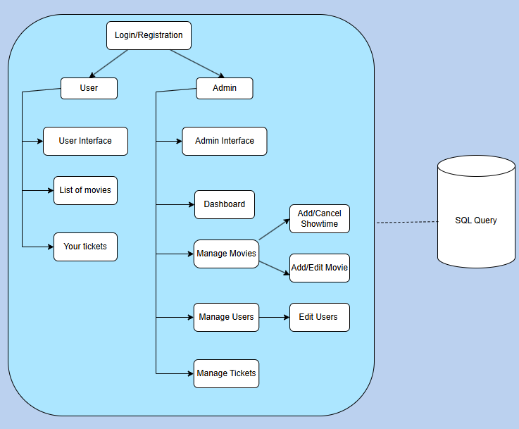
SYSTEM DESIGN

Slide 4
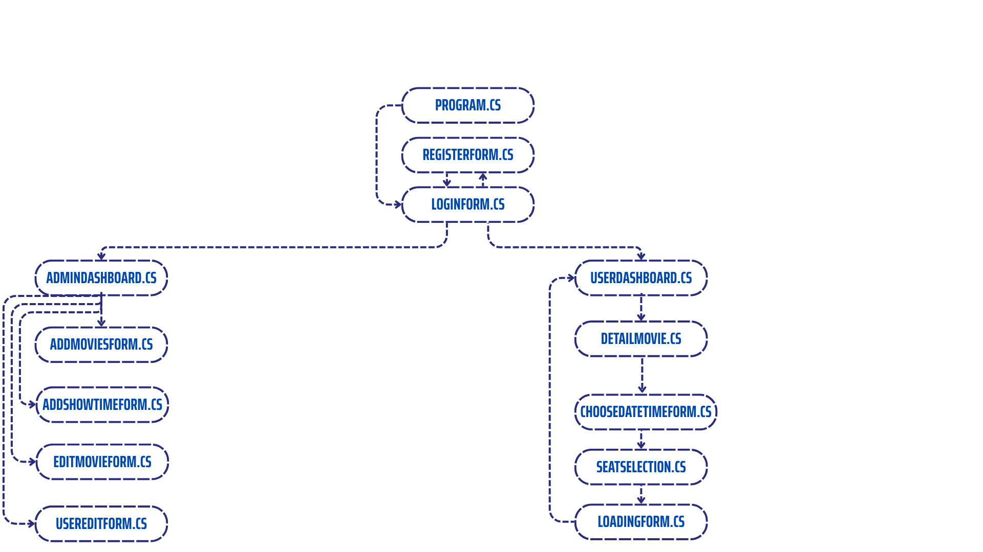
FUNCTIONAL MODULE DESCRIPTION
Entry point for the application, open LoginForm.cs initially
Allows new users to register
Authenticates users and admins, if user ⟶ open userdashboard.cs, if admin ⟶ open AdminDashboard.cs
Central control panel for admins, which allows managing movies, showtimes, user accounts, and total reserved tickets.
Presents available movies, upcomming showtimes, booking options, and reserved tickets.
Interface to add new movies into the system
Input movie details, select poster images.
Displays additional information about a selected movie: description, duration, poster, etc.
Interface to schedule showtimes
Select movie, premiere date, specific theater.
Allows users to pick a showtime of selected movie by choosing date and time.
Allow editing existing movie, updating movie details.
Display available seats, total price based on number of selected tickets, and other infomation.
Allow admin to view and modify existing user information.
Display a reload progress bar for 200ms and return to the userdashboard menu.

Slide 5
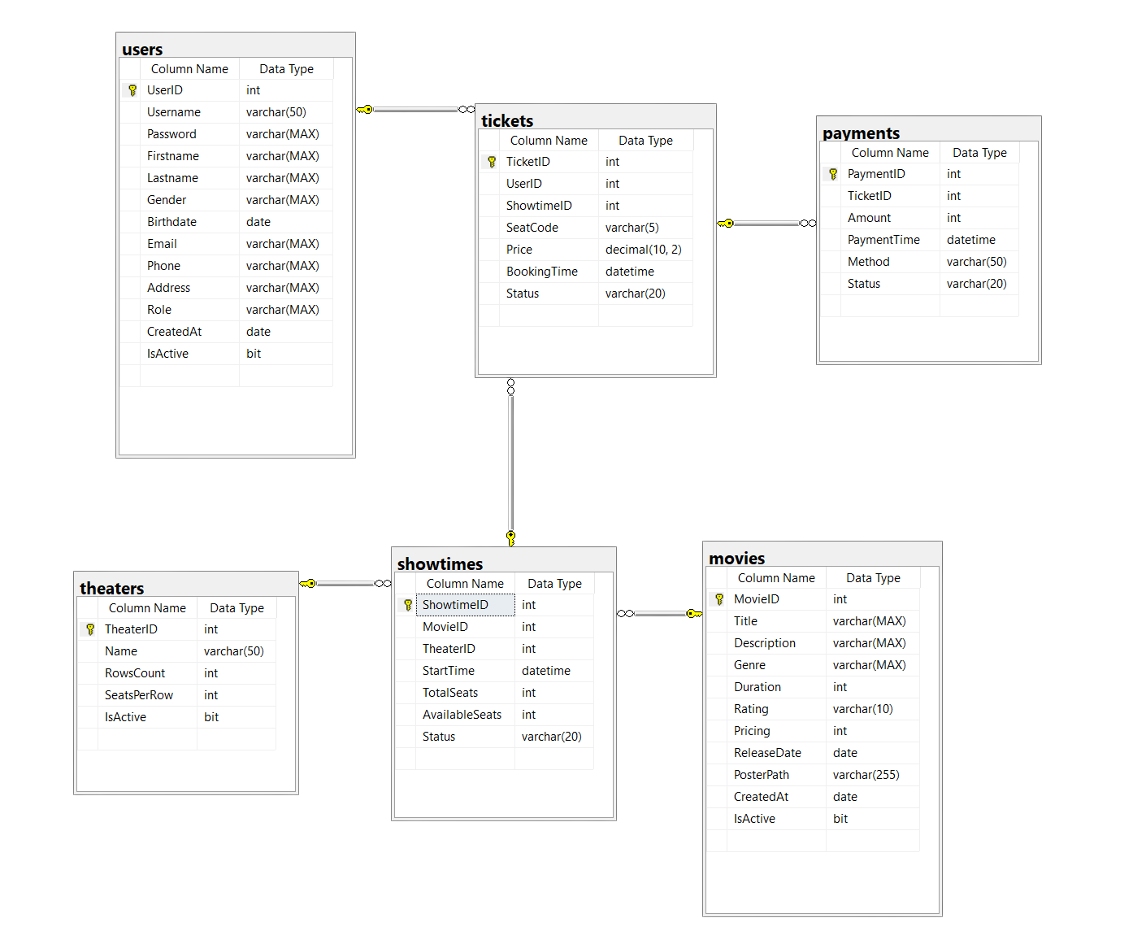
ENTITY RELATIONSHIP DIAGRAM
CURRENTLY NOT IN USE

Slide 6
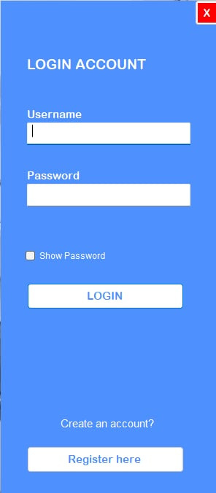
LOG IN AND REGISTER

Slide 7
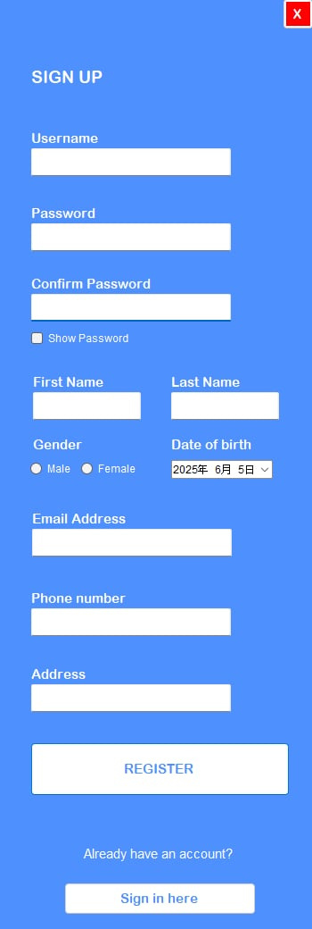
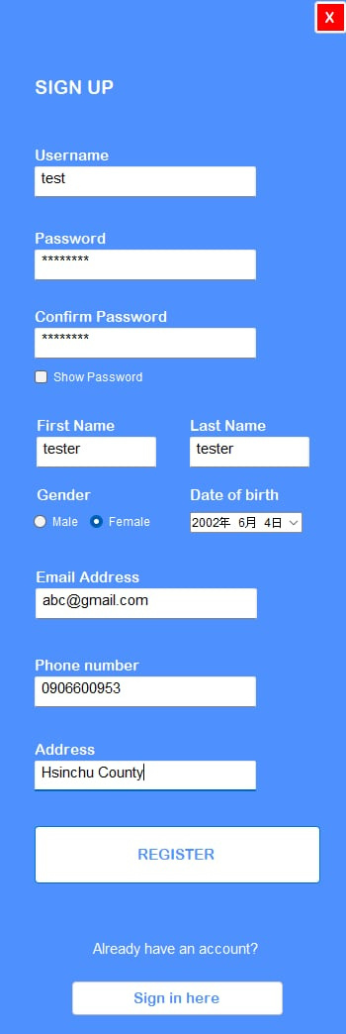
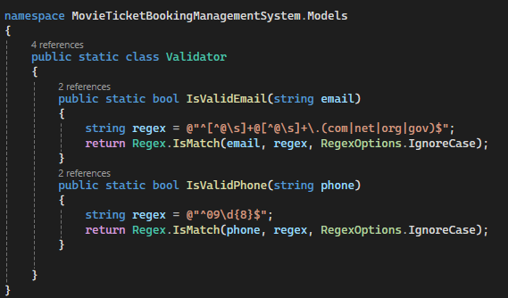
LOG IN AND REGISTER
PASSWORD MUST BE AT
LEAST 8 DIGITS LONG
MUST HAVE A CORRECT
FORM OF AN EMAIL
[EMAILNAME]@[DOMAIN].[COM|NET|ORG|GOV]
PHONE NUMBER MUST START WITH 09
AND MUST HAVE 10 DIGITS

Slide 8
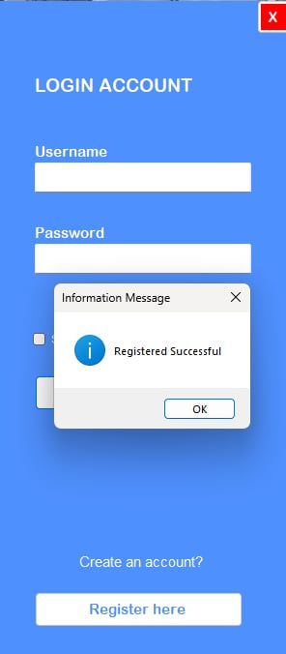
LOG IN AND REGISTER
SHOWPASSWORD

Slide 9
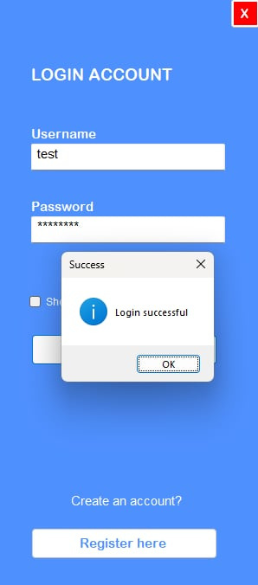
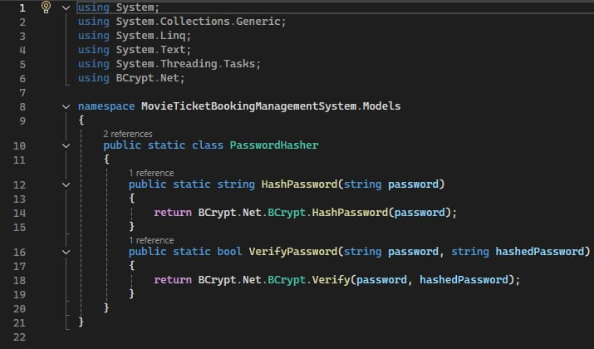
LOG IN AND REGISTER

Slide 10
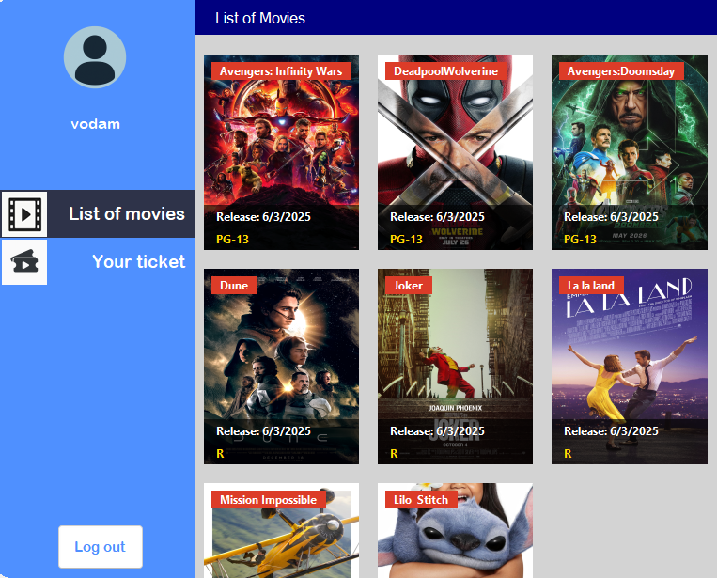
USER DASHBOARD
Notes:
這是使用者介面，包含電影列表和已購票。在電影清單區，您可以選擇想觀看的電影併購票，選擇想看電影的日期和時間，然後進入座位選擇區。白色座位表示可選座位，綠色座位表示已選座位，紅色座位表示已選座位。之後，您可以在已購票區查看您已購票的資訊。

Slide 11
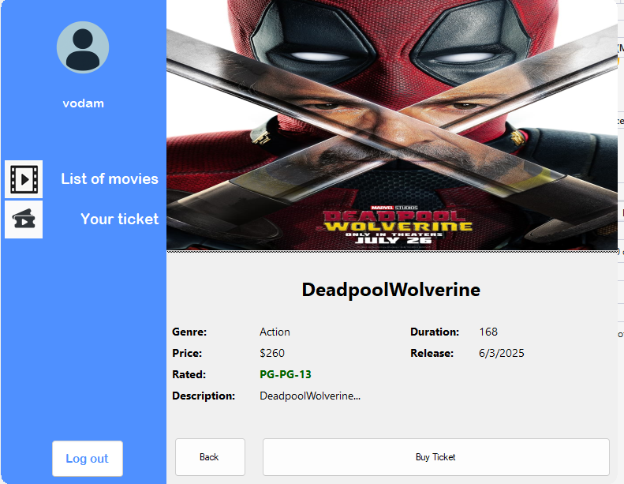
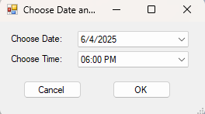
USER DASHBOARD

Slide 12
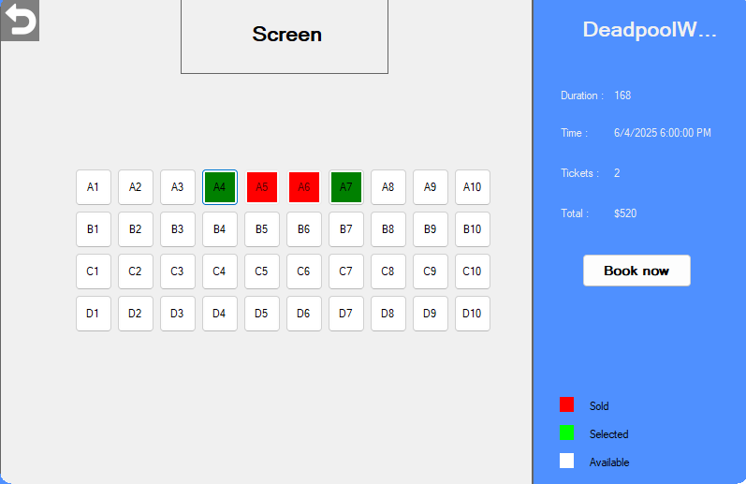
USER DASHBOARD

Slide 13
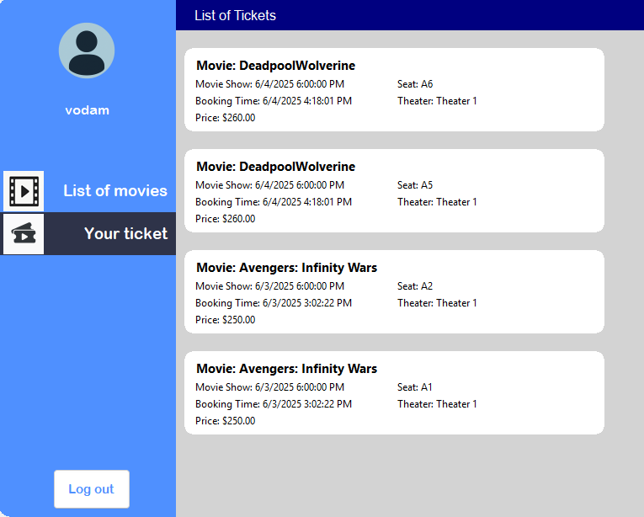
USER DASHBOARD

Slide 14
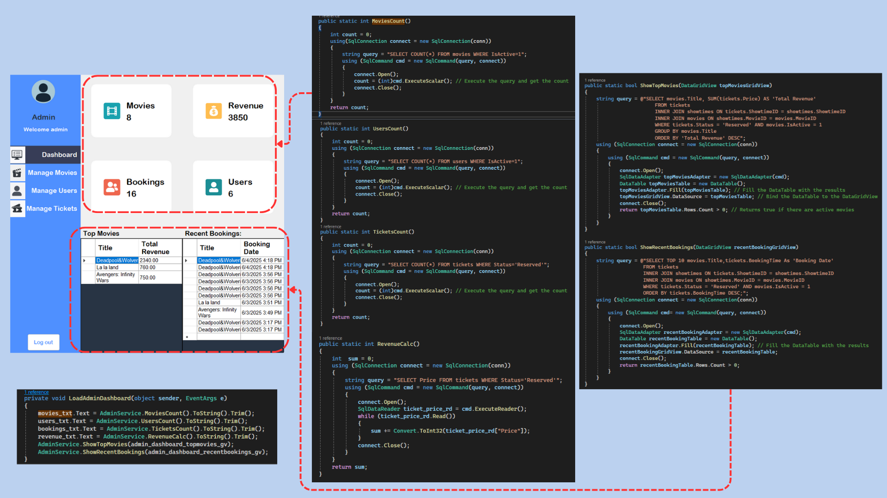
ADMIN DASHBOARD

Slide 15
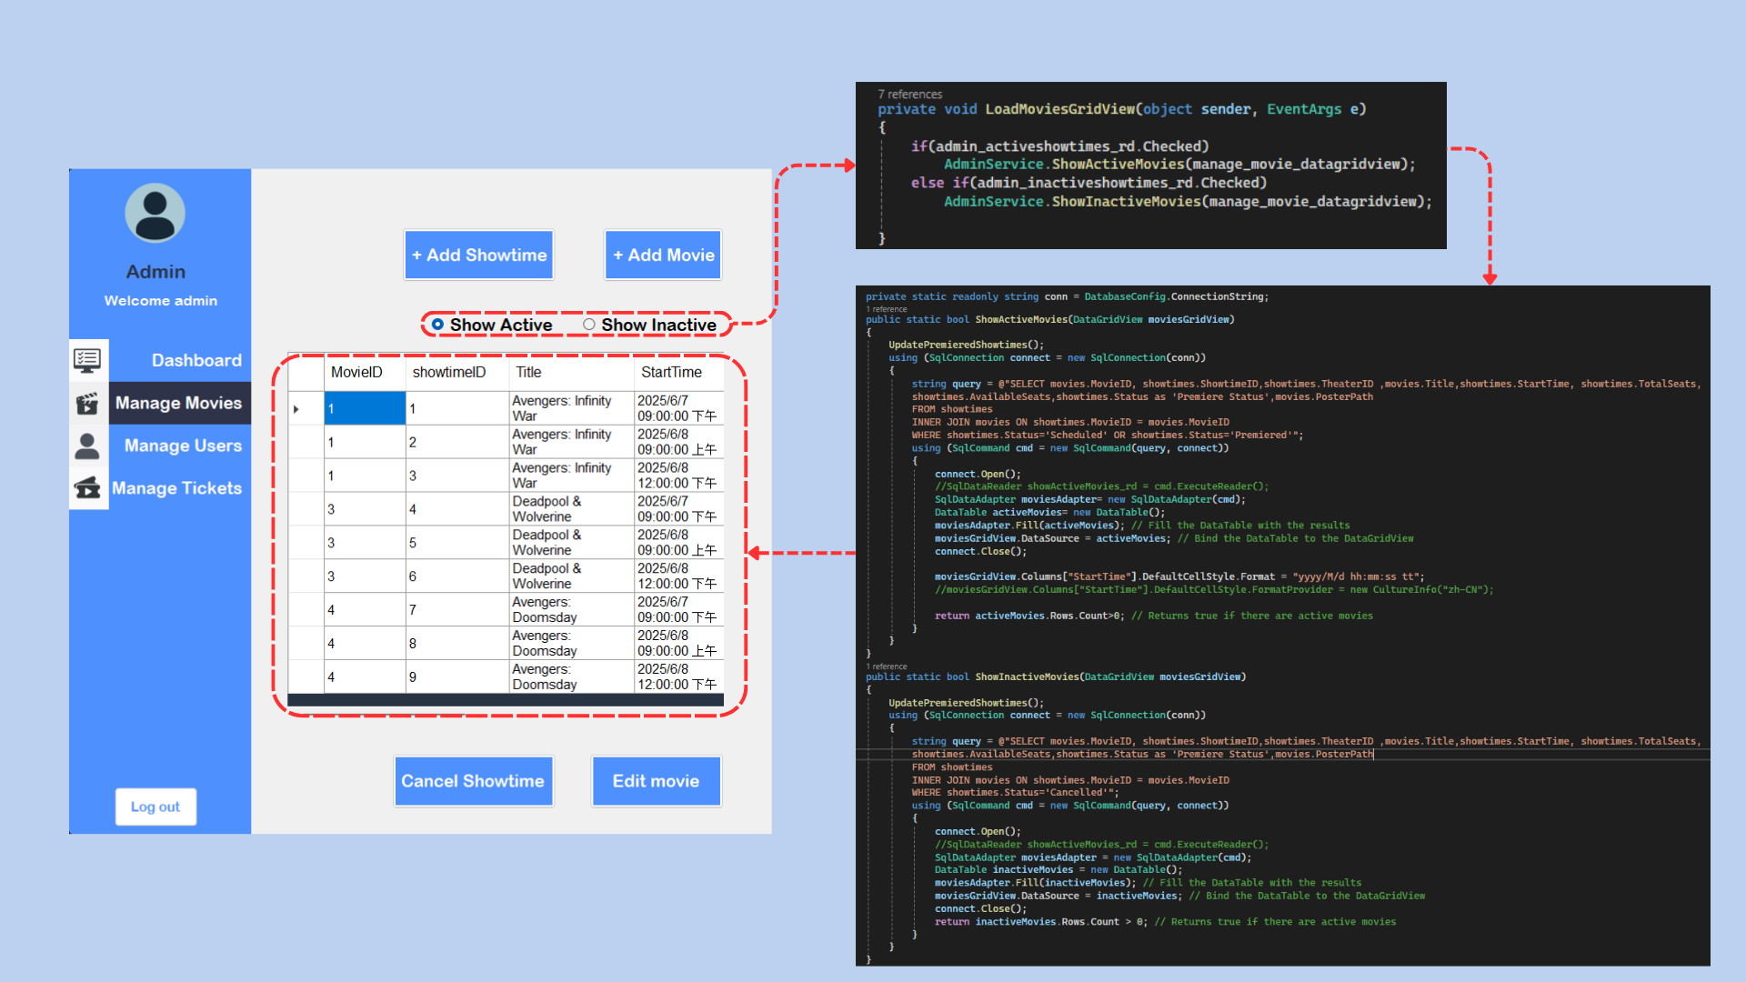
ADMIN DASHBOARD

Slide 16
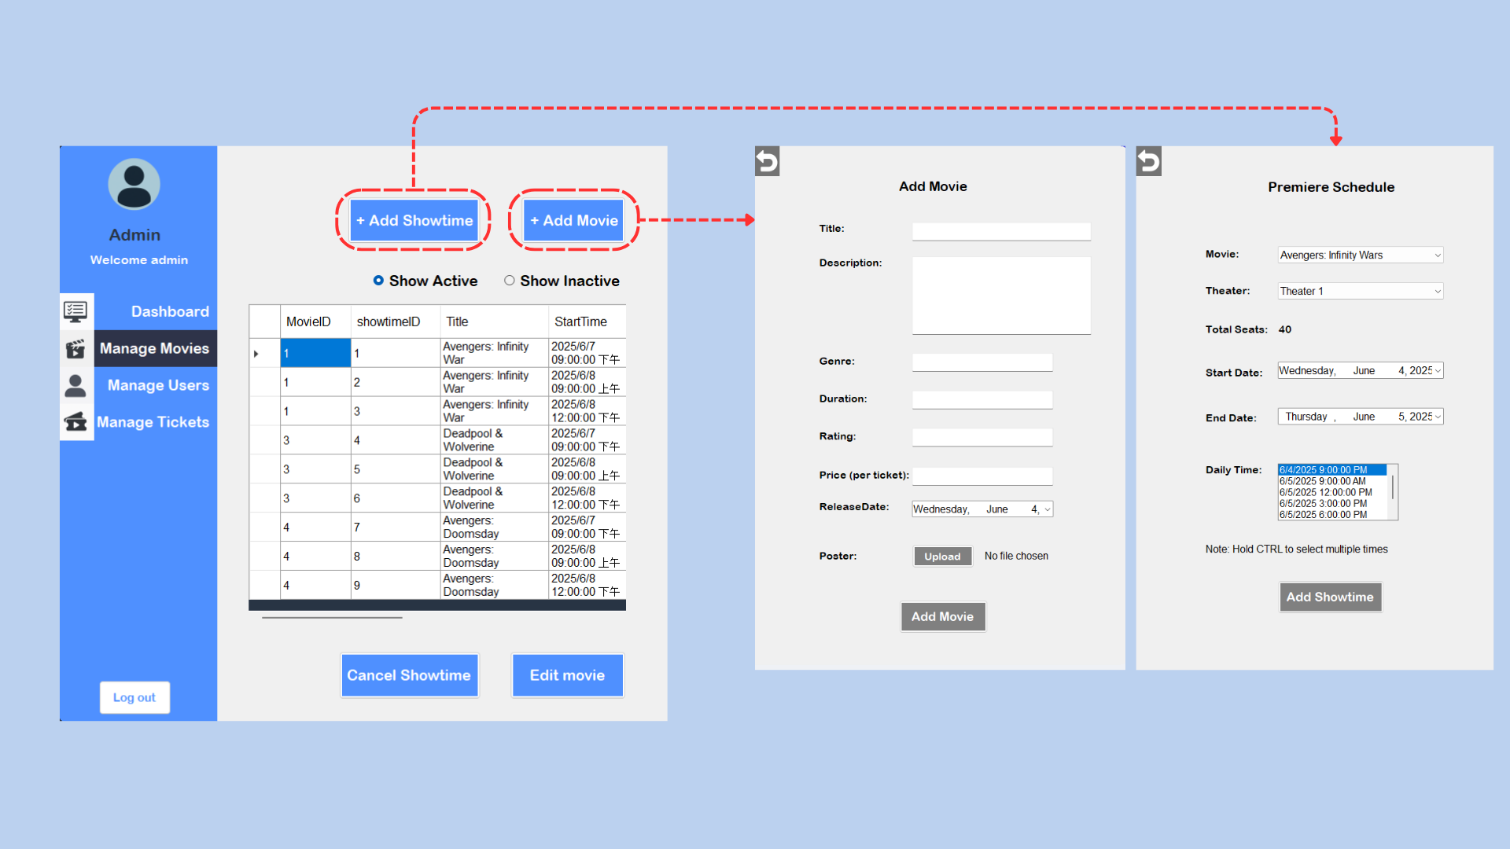
ADMIN DASHBOARD

Slide 17
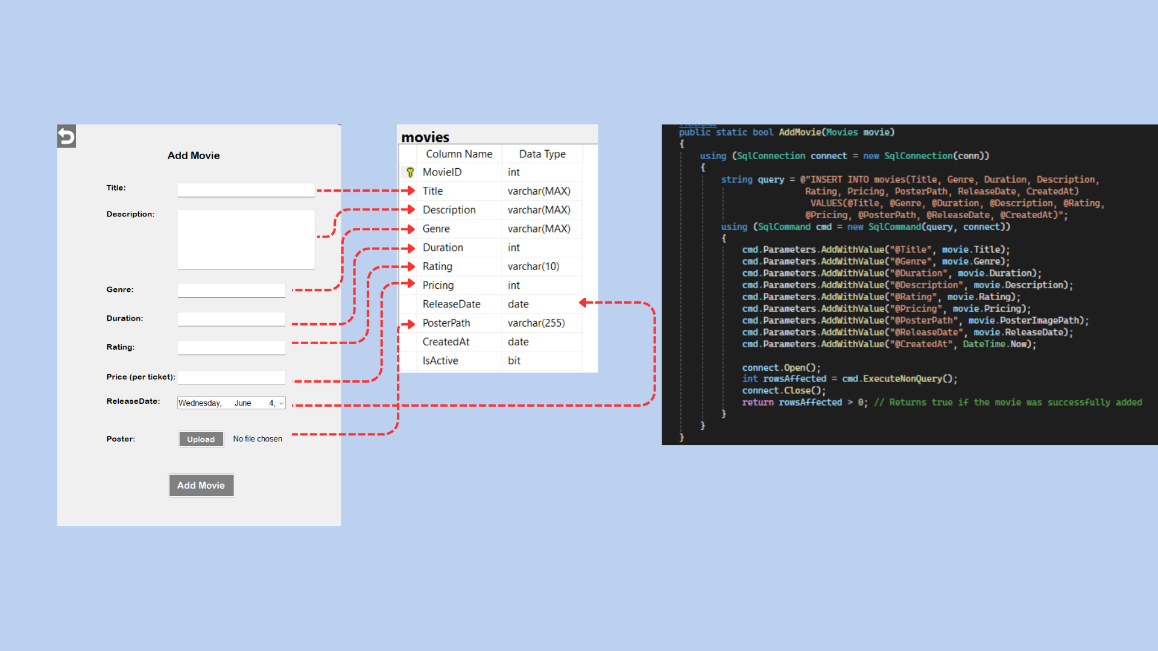
ADMIN DASHBOARD
ADDMOVIESFORM.CS
ADMINSERVICE.ADDMOVIE()
Note: Duration is movie duration in minutes
Rating is age rating of the movie

Slide 18
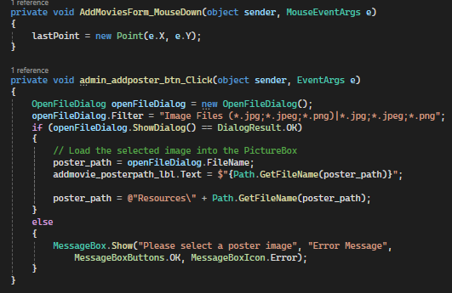
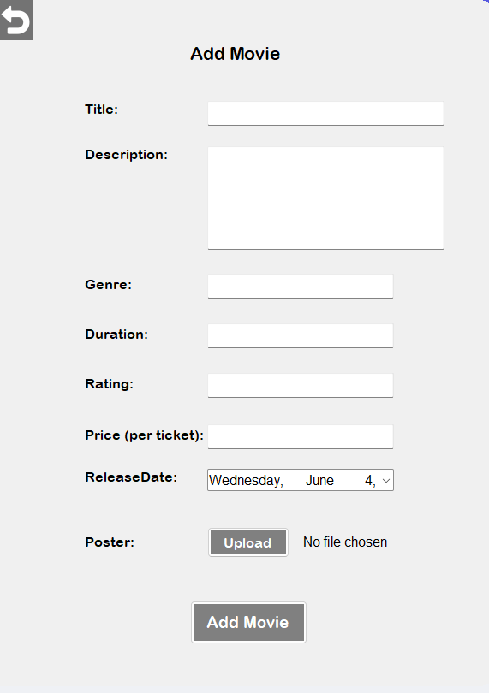
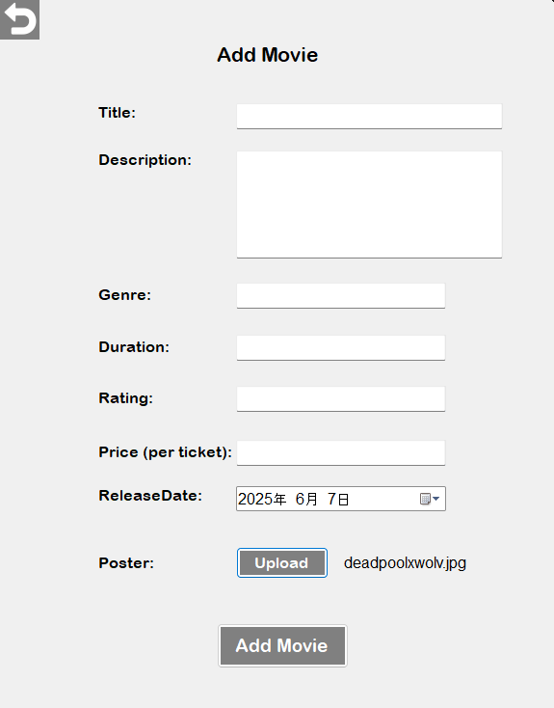
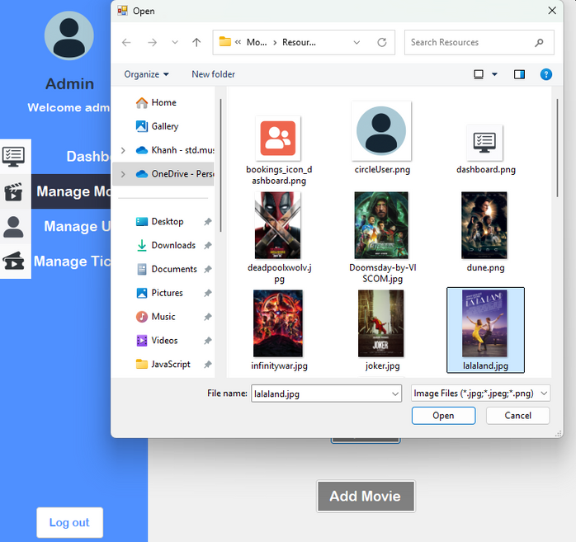
ADMIN DASHBOARD
ADDMOVIESFORM.CS
Before upload
Upload poster logic
After choosing an image

Slide 19
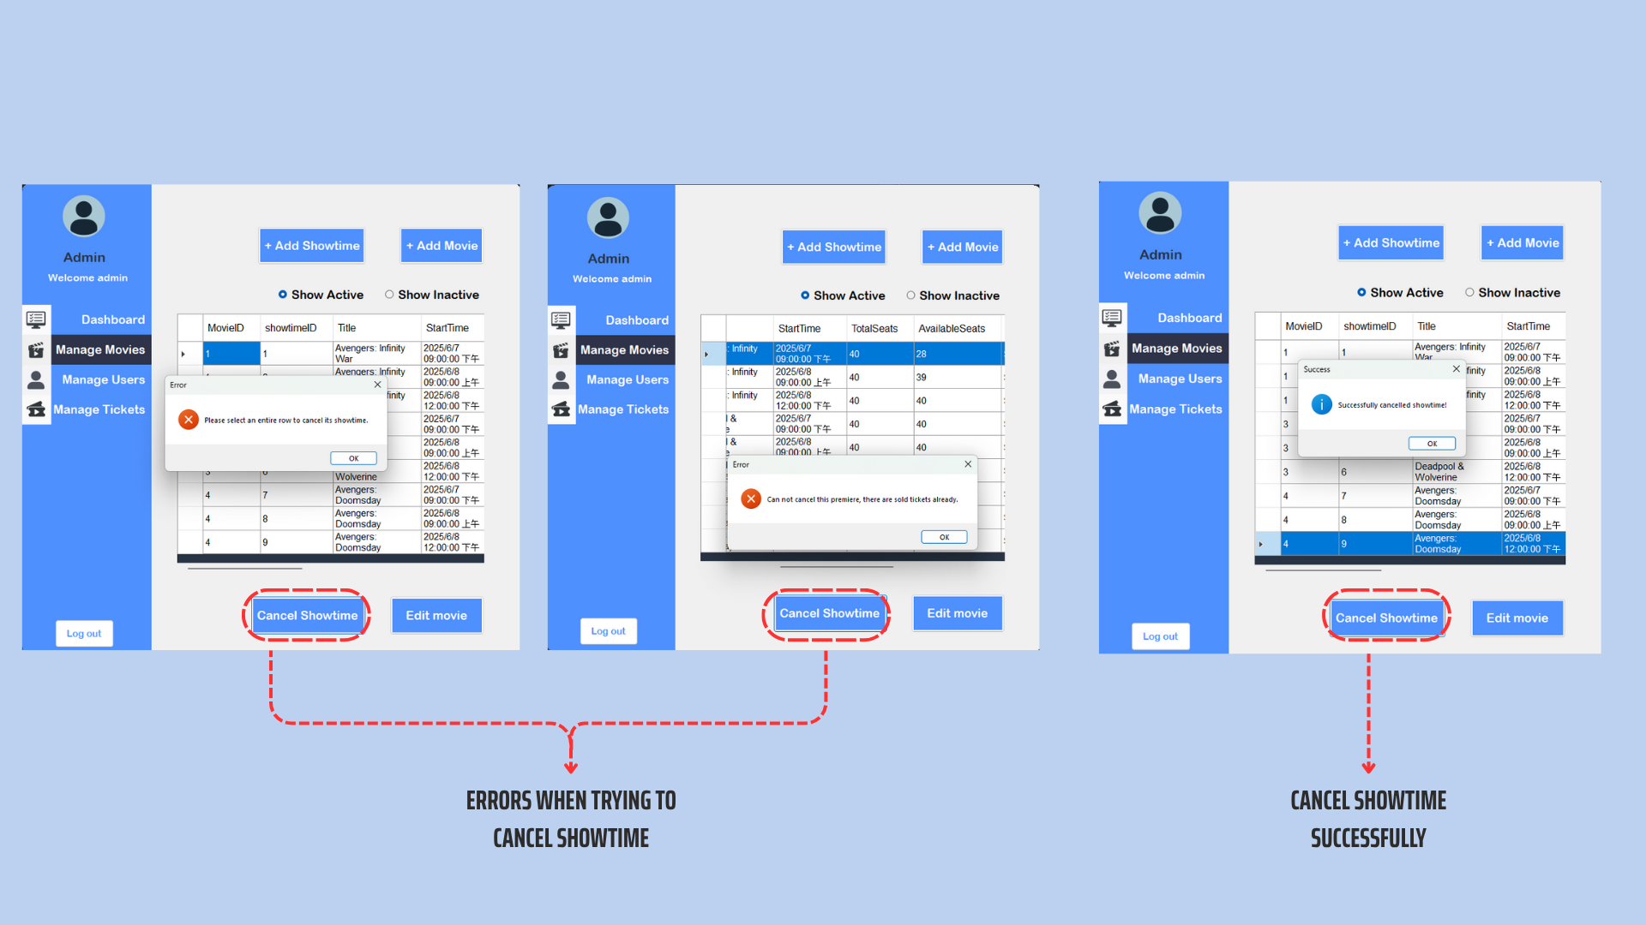
ADMIN DASHBOARD
ERRORS WHEN TRYING TO CANCEL SHOWTIME
CANCEL SHOWTIME SUCCESSFULLY

Slide 20
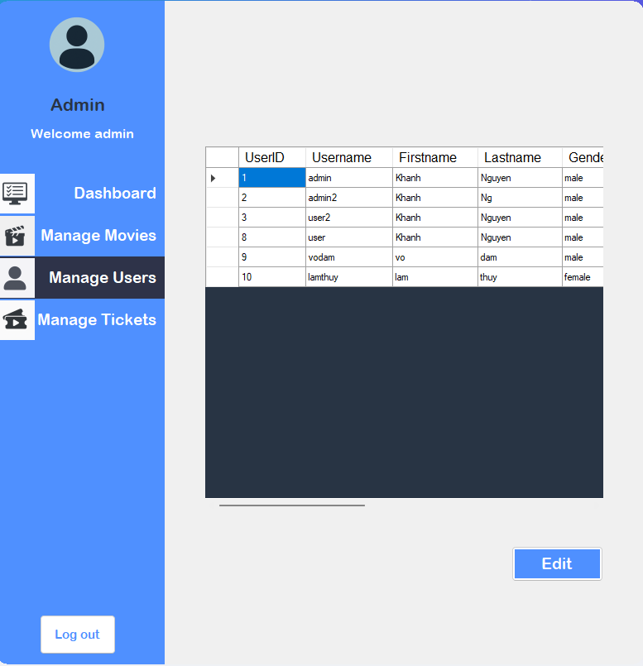
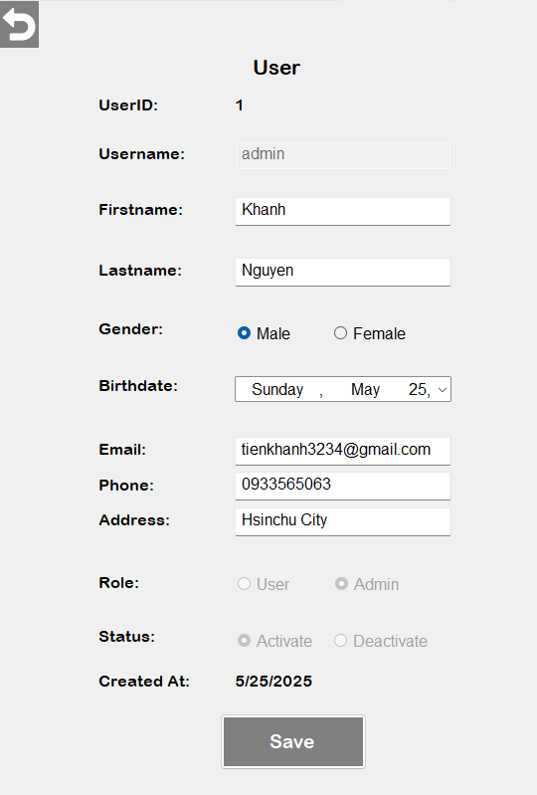
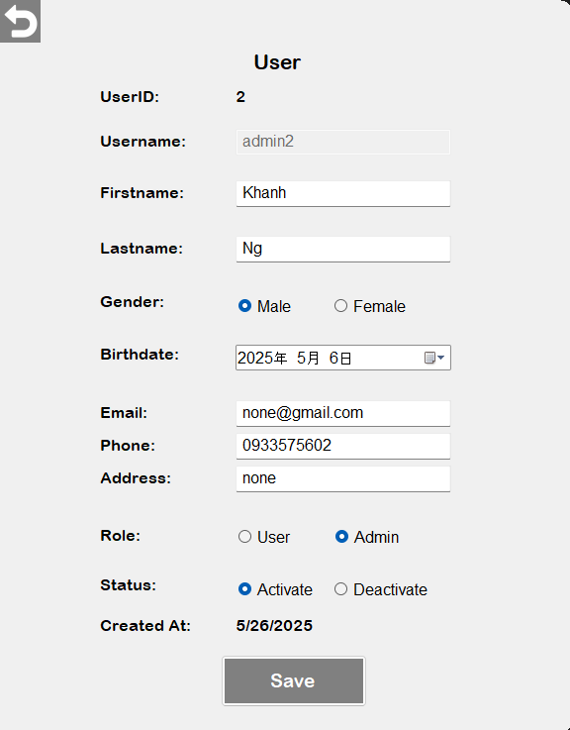
ADMIN DASHBOARD
CANNOT EDIT ROLE AND STATUS OF
USERID 1 ADMIN
NORMAL CASE

Slide 21
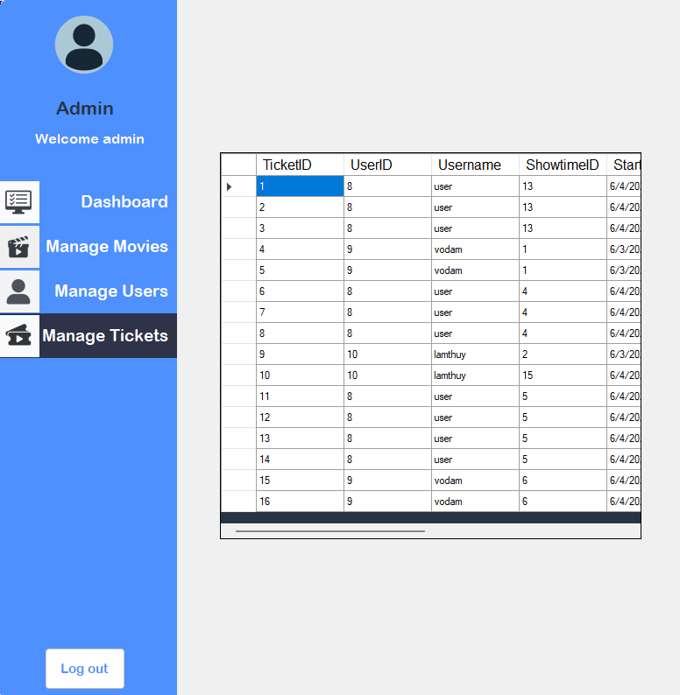
ADMIN DASHBOARD

Slide 22
CONCLUSION
THE MOVIE TICKETING SYSTEM IS DESIGNED TO IMPROVE THE USER EXPERIENCE, FROM SEARCHING FOR MOVIE INFORMATION TO PURCHASING TICKETS AND CHOOSING SEATS. THE SOFTWARE HAS ACHIEVED ITS MAIN GOALS, INCLUDING A USER-FRIENDLY INTERFACE, A QUICK TICKET BOOKING PROCESS, AND EFFICIENT MANAGEMENT CAPABILITIES FOR THEATERS.
PROJECT LIMITATIONS
THE CURRENT SYSTEM DOES NOT SUPPORT MULTIPLE LANGUAGES ​​OR INTEGRATE WITH INTERNATIONAL PLATFORMS.
THERE IS NO TICKET PRINTING FUNCTION YET.
FUTURE IMPROVEMENTS
CROSS-PLATFORM SUPPORT: IMPROVE THE EXPERIENCE ON MOBILE DEVICES AND WEB APPLICATIONS.
DATA ANALYSIS: ADD DETAILED REPORTING FUNCTIONS TO HELP THEATERS BETTER UNDERSTAND CUSTOMER BEHAVIOR.
Notes:
結論
電影票預訂管理系統旨在提升使用者體驗，涵蓋從搜尋電影資訊到購票和選座的完整流程。該軟體已實現其主要目標，包括用戶友好的介面、快速的訂票流程以及高效的影院管理功能。
項目局限性
目前系統不支援多種語言，且不支援與國際平台整合。
暫不支援列印票務功能。
未來改進
跨平台支援：提升行動裝置和網頁端的體驗。
數據分析：增加詳細的報表功能，幫助戲院更了解客戶行為。

Slide 23

謝謝大家的聆聽Thank you for listening

